Slide 1
Robot Arm Project
Abdalrahman Albakatoshy Ahmed Mostafa Talaat
Ahmed Mohamed Mosaad

Slide 2
Overview of all Projects
Project One – Bluetooth-Controlled Home Automation System
Project Two – Autonomous RC Car
Project Three – Robotic Arm
Project Four – Automated Industrial Production Line Using Color Sensor
Project Five – Voice Recorder
Project Six – Real-Time Clock
Project Seven – Speaking System for Mute People Using Hand Gestures
Project Eight – Fingerprint-Based Security and Control System

Slide 3
Overview
We developed a robotic arm capable of precise movement control using servo and stepper motors. It is designed for industrial-style object manipulation, with a gripper for picking and placing items, and a keypad/LCD interface for manual operation.
Main Features
Arm Control Mechanism: Servo motors for joint control and stepper motors for base rotation.
Gripper Mechanism: Servo-controlled gripper for object handling.
User Interface: Keypad for manual control and LCD for real-time feedback. The project aims to provide a flexible, programmable, and user-friendly robotic arm platform that can be adapted for training, automation experiments, and small-scale industrial processes.

Slide 4
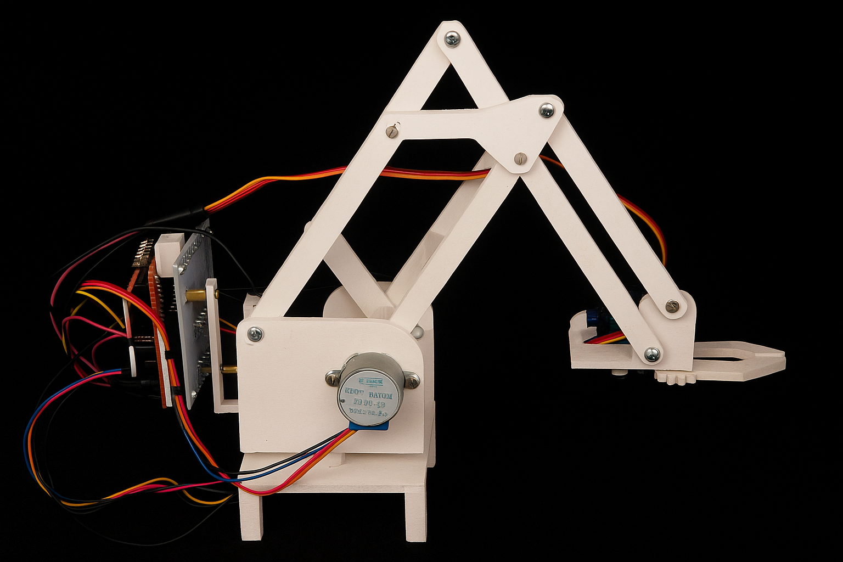

Slide 5
Components
1
3
2
4
stepper motor 28byj-48 and ULN2003 Driver
MG90S Servo
Stepper 1 – base rotation
Stepper 2 –shoulder movement
Stepper 3 – elbow movement
control the gripper
LCD
KEYPAD

Slide 6
Functionality
Stepper Motor Control: Each key on the keypad maps to specific arm movements — clockwise or counterclockwise rotation for each stepper.
Servo Control: A single button toggles the gripper between open and closed states.
Feedback Display: LCD shows the current operation ("Stepper1: CW", "Gripper Closed", etc.).
Movement Precision: Stepper motors move in fixed 35° increments per command.
PWM for Servo: Timer1 generates PWM signals to set servo angles between 0°–180°.

Slide 7
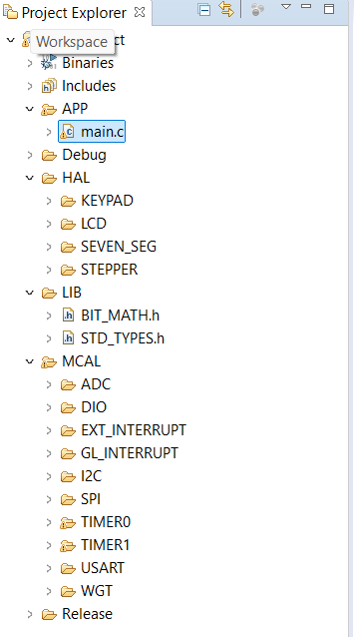
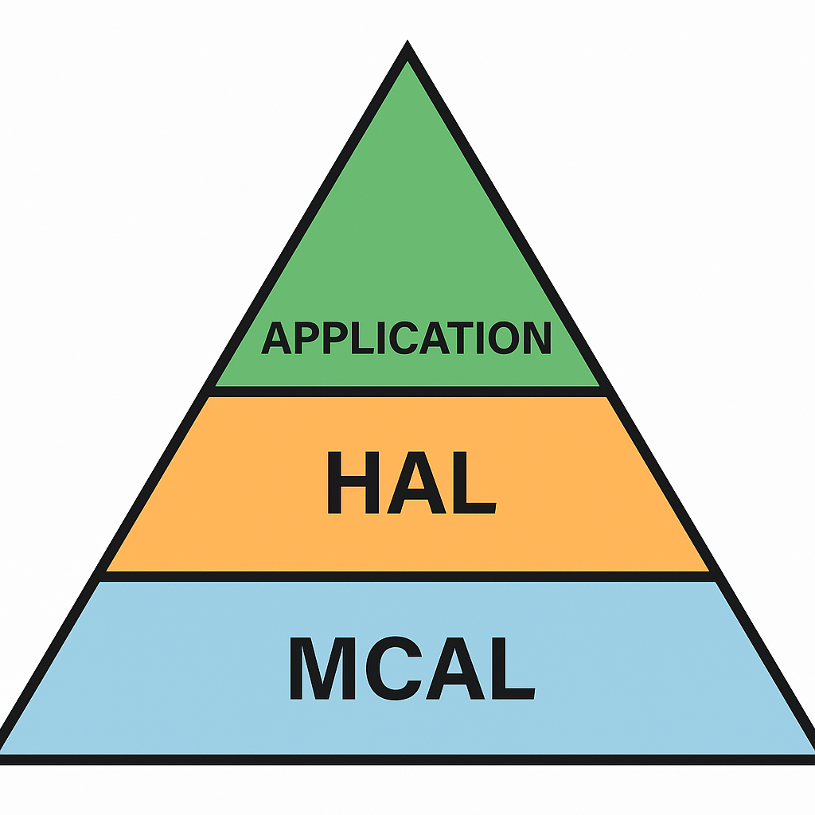
Used Device Driver
Timer1
Interrupt
Stepper
DIO
Keypad
LCD

Slide 8
Testing
Unit Testing
Intergration Testing
Regression Testing
Functional Testing

Slide 9
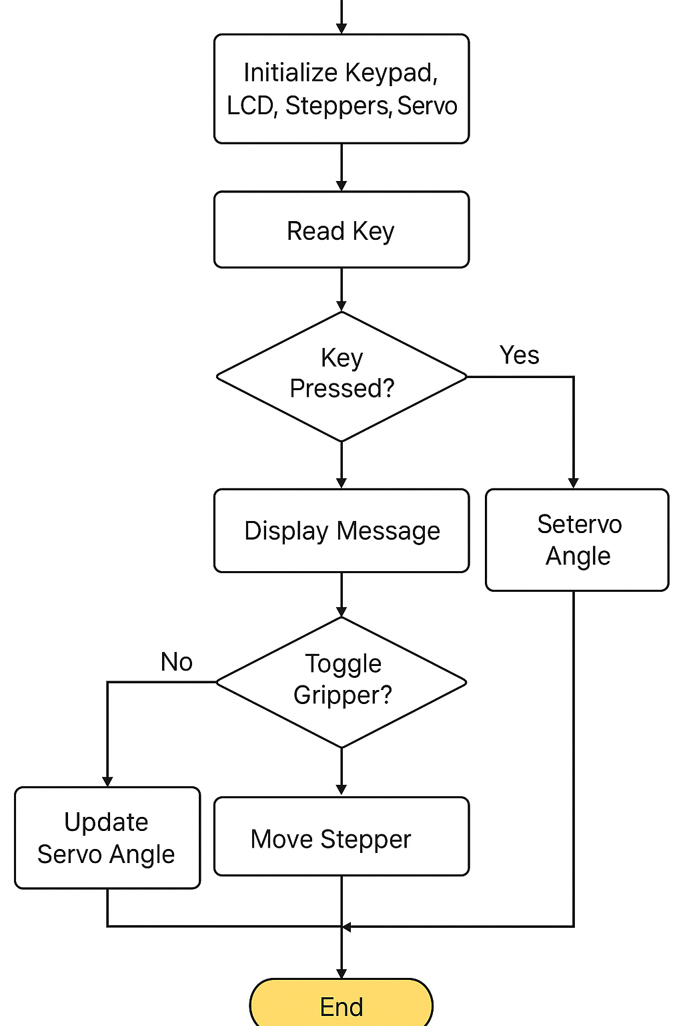
Flow Chart
In this robotic arm code, keypad buttons control the steppers and gripper.
'1' → Stepper 1 CW, '2' → Stepper 1 CCW,
'3' → Stepper 3 CW, '4' → Stepper 3 CCW,
'7' → Stepper 2 CW, '6' → Stepper 2 CCW.
'5' toggles the gripper open/close, and any other key shows “Invalid Key” on the LCD.

Slide 10

Problems
LCD
Stepper
We used the LCD in 4-bit mode instead of 8-bit mode to save microcontroller pins, as available I/O pins were limited.
We used the ULN2003 driver to control the stepper motor and protect the circuit by handling the motor’s current.
Servo
Design
We used a servo with a larger torque
We designed a more compact mechanical structure capable of rotating 360 degrees

Slide 11
Future Development
Inertial Measurement Unit (IMU): An IMU will be added to monitor the arm’s orientation and movement in real-time, enabling smoother and more precise motion control, as well as automatic correction for positioning errors.
Vision-Based Object Detection: A camera module will be integrated with image processing algorithms to detect objects in the workspace. This will allow the arm to autonomously locate, identify, and align with targets before gripping them.
Joystick Control: The current keypad interface will be replaced with a joystick for more intuitive, proportional, and fluid movement control, allowing the operator to guide the arm naturally in multiple directions at variable speeds.

Slide 12
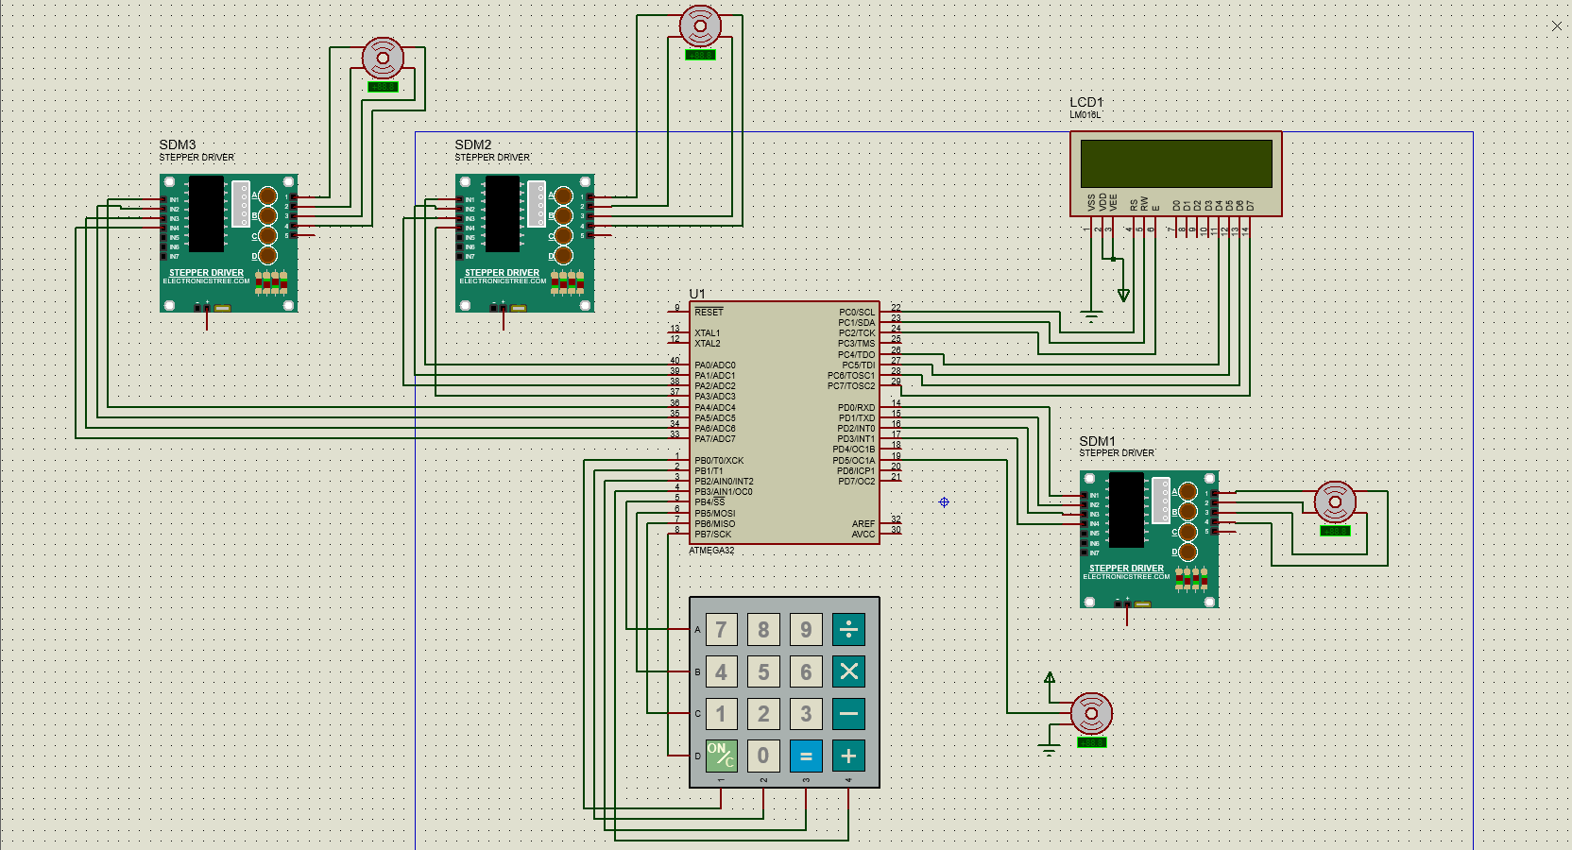
PROTEUS

Slide 13
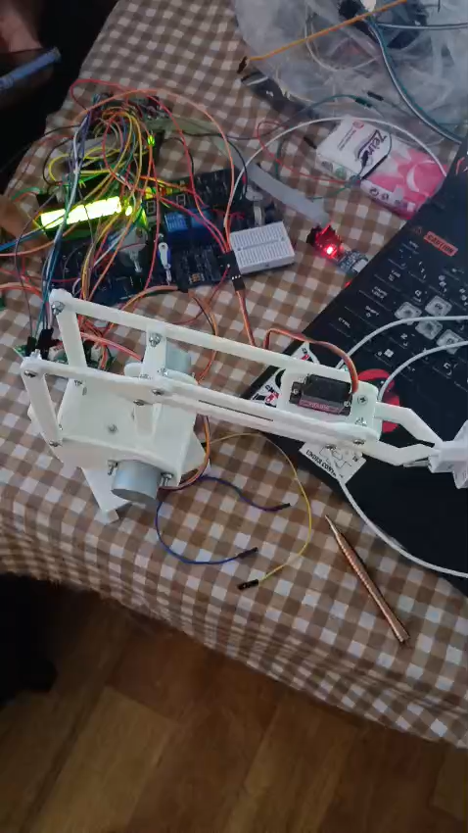

Slide 14

Thank you

Slide 15
Thank you

